Slide 1
ENGI 301 Sun Clock Proposal
10/20/2019
Annabel Chang

Slide 2
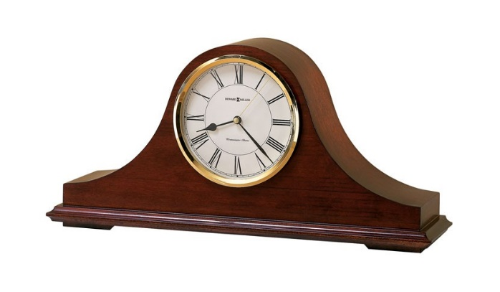


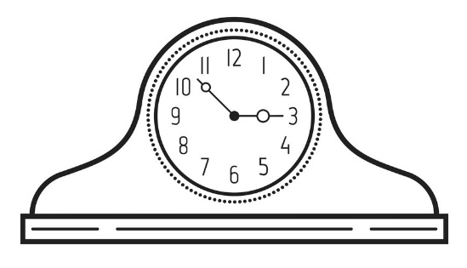

Background Information
What is being proposed?
Clock that shows the position of the sun and has a screen display of time; alarm can be set by user through mode, hour, and minute buttons
Pictures:
What improvements / additions over existing project
No need to reset time after battery death due to RTC; visualization of time through moving sun; set alarm function
(moon will rotate up during night)
-> Sun is up during day
-> screen

Slide 3
Background Information (cont.)
Links to existing projects / libraries:
PocketBeagle: https://www.mouser.com/ProductDetail/BeagleBoard-by-GHI/PocketBeagle-SC-569?qs=YCa%2FAAYMW00RLPkeA%2FnP9A%3D%3D
Adding RTC to BeagleBone Black: https://learn.adafruit.com/adding-a-real-time-clock-to-beaglebone-black/overview
RTC Arduino library: https://github.com/adafruit/RTClib
TFT screen: https://github.com/adafruit/Adafruit_TouchScreen
PB project using screen: https://www.mouser.com/applications/retro-arcade-build/
Resistive touch screen controller: https://github.com/adafruit/Adafruit_STMPE610
Buzzer: https://www.adafruit.com/product/1536

Slide 4
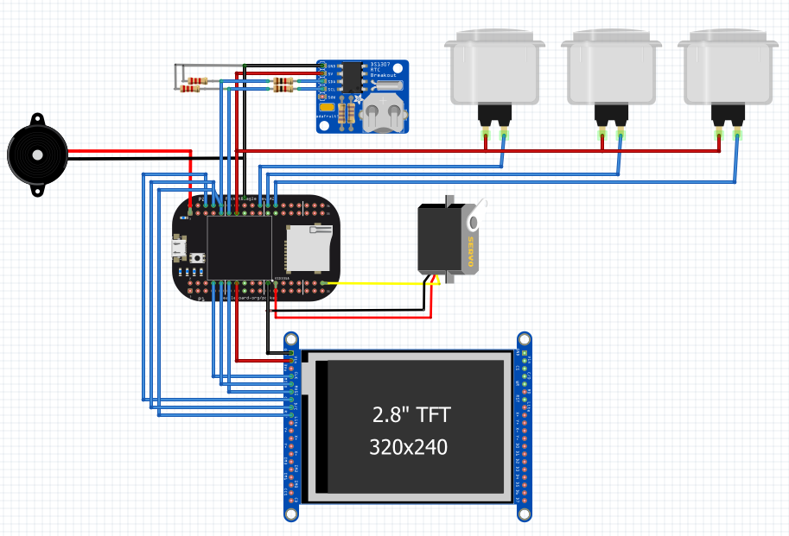
System Block Diagram
RTC DS1307
I2C1
Buttons
GPIO 64, 46, 48
1kΩ Resistor
Speaker
1536
PWM1
22kΩ Resistor
Servo FS5103R
PWM0
PocketBeagle
Touch screen ILI9341
SPI0

Slide 5
Power Block Diagram
3.3V
5V
3.3V
3.3V
5V
3.3V

Slide 6
Components / Budget
Component | Need to Buy | Cost
PocketBeagle-SC-569 | N
HS-422 Servo | N
Adafruit DS1307 Real Time Clock Assembled Breakout Board | Y | $7.50
CR1220 12mm Diameter - 3V Lithium Coin Cell Battery - CR1220 | Y | $0.95
Buzzer 5V - Breadboard friendly | N
2.8" TFT LCD with Touchscreen Breakout Board w/MicroSD Socket - ILI9341 | Y | $29.95
Pushbuttons with Covers x3 | N
Resistors (1kΩ x2, 22kΩ x2) | N
Breadboard + Wiring | N
Resistive Touch Screen Controller - STMPE610 | Y | $9.95
Jackery [The Smallest] Mini 3350mAh Portable Charger Power Outdoors - External Battery Pack, Premium Aluminum Power Bank, Portable iPhone Charger for iPhone, Samsung Galaxy and Other Phone (Black) | Y | $15.99

Slide 7
Future Plans
Casing
Replace physical buttons with touchscreen buttons
Replace power cable with battery
Other modes: photo gallery, temperature/humidity detection, etc.

